Slide 2
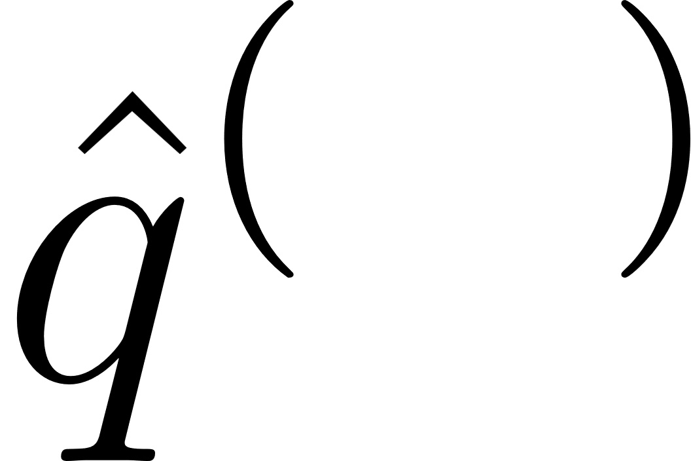
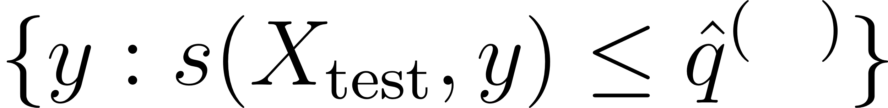

Slide 3
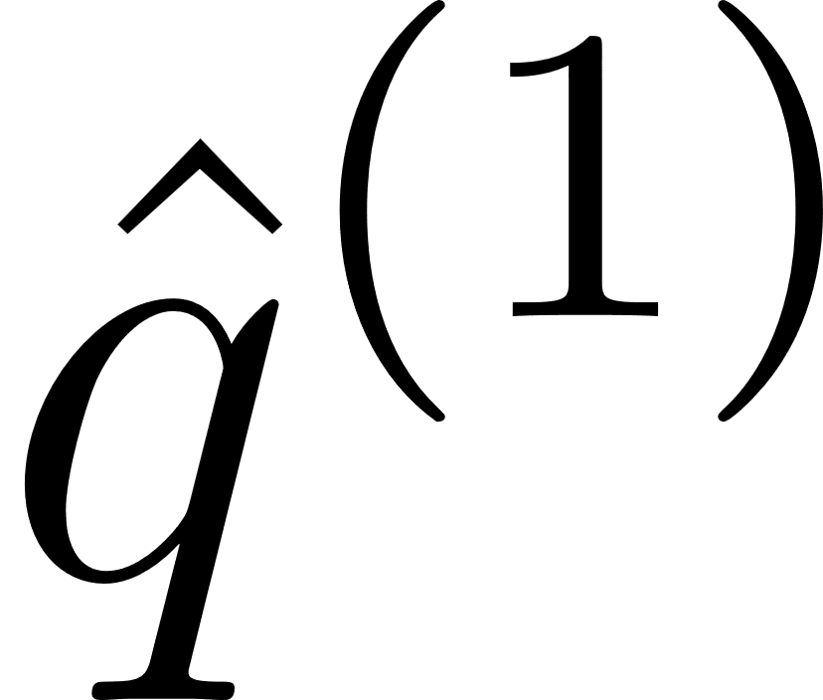
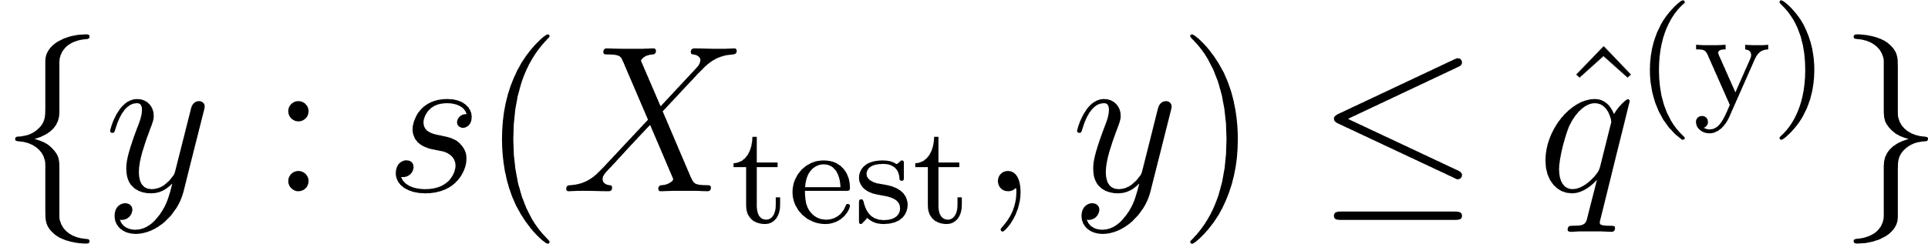
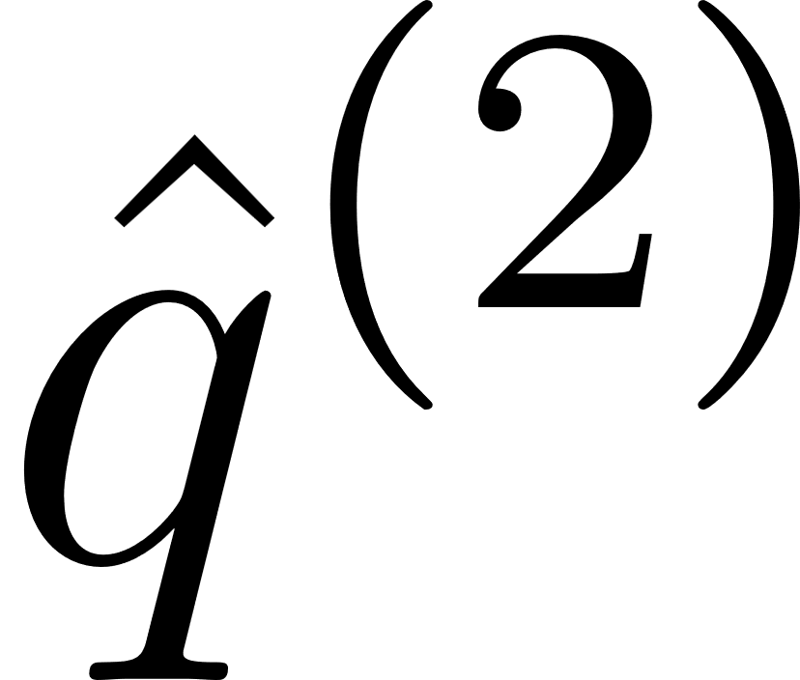

Slide 4
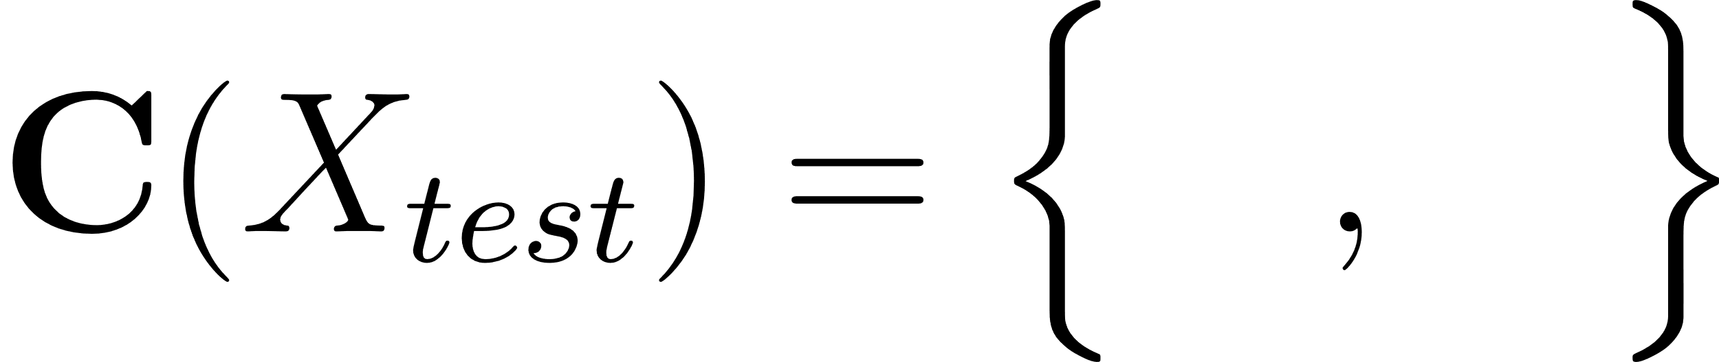
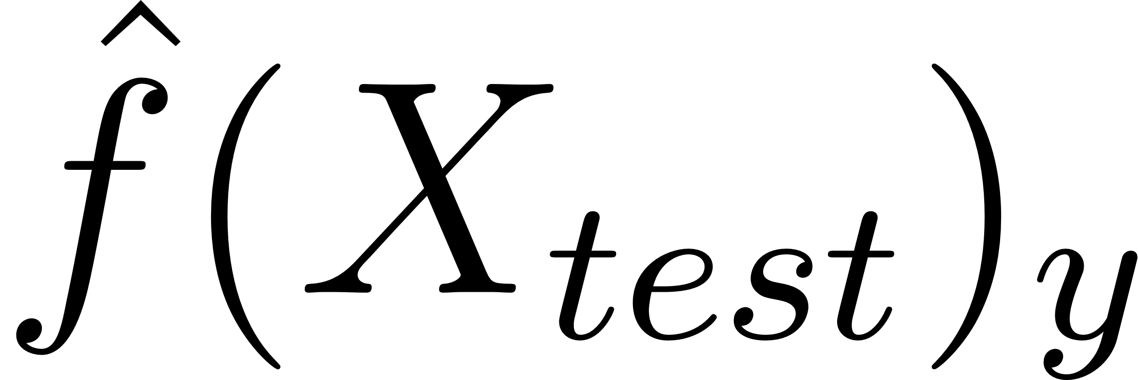
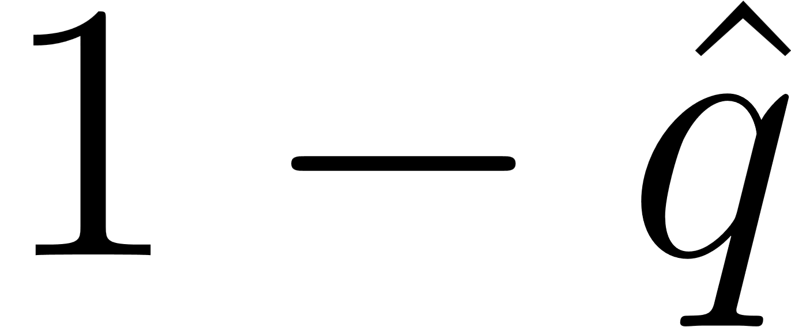
classes y

Slide 5
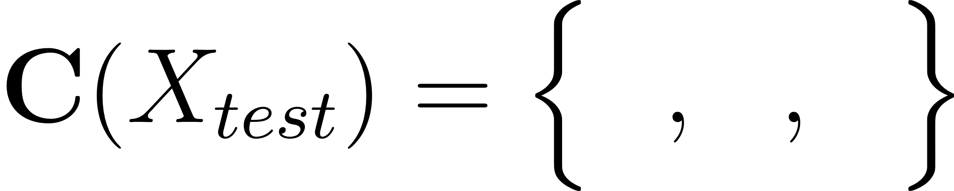
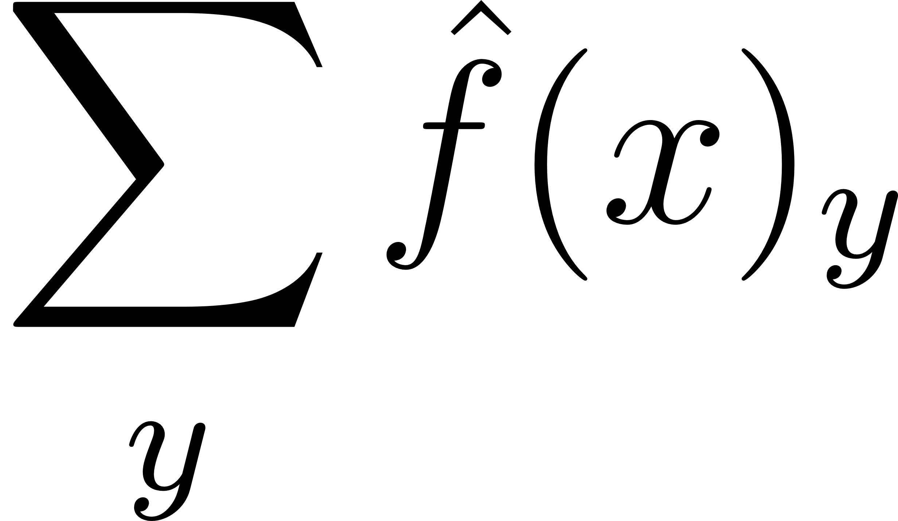
classes y
classes y

Slide 6
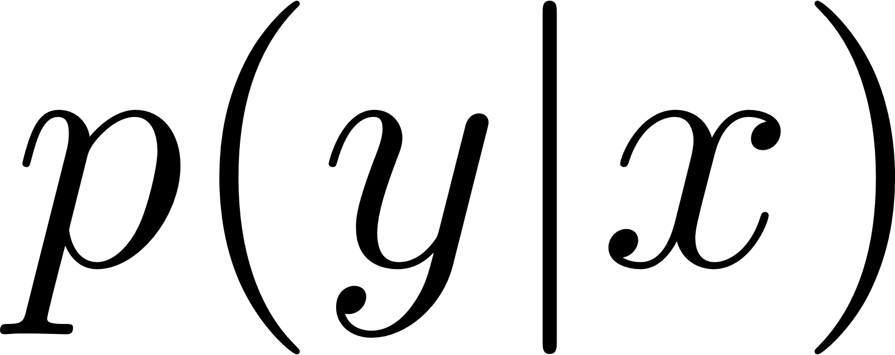
classes y
classes y
classes y

Slide 7


#
#
#
set size
set size
set size

Slide 8


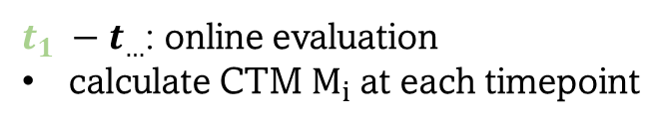








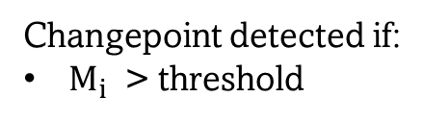
distribution p1
distribution p2
change point
$$t_{0}$$
$$t_{1}$$
$$t_{2}$$
…
$$t_{θ−1}$$
$$t_{θ}$$
$$t_{θ+1}$$
$$t_{θ+2}$$
$$…$$
$t_{0}$: train model on p1
$t_{1} −t_{…}$: online evaluation
calculate CTM $M_{i}$at each timepoint
Changepoint detected if:
$M_{i}$ > threshold

